Slide 1
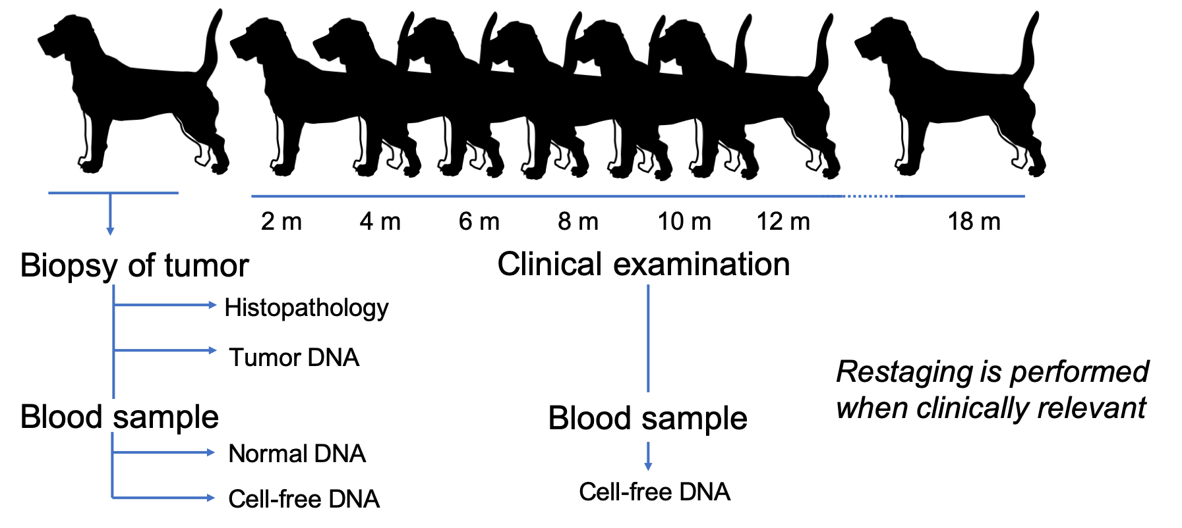
ctDNA in dogs with mammary tumors
Proof-of-concept
Is cfDNA present in dogs
Is the amount stable over time
Is ctDNA is present in these dogs?
Benign tumors
Carcinomas
Monitoring
Is ctDNA detectable before/at relapse in carcinomas?
Notes:
Right now, it’s hard to follow disease progression of cancers due to the relative low sensitivity and invasiveness of imaging modalities. We’re looking into following disease progression using liquid biopsies. The idea is to find tumor-specific mutations in the tumor and then looking for these in the liquid biopsy.
The focus is to 1) is it present 2) is it useful for tracking mammary tumor progression and tumor evolution.
Prove that ctDNA is present in dogs with aggressive mammary tumors
Follow the levels of ctDNA over time
Is ctDNA present before metastasis / regrowth is observed by conventional means?
Follow evolution of mutations over time – f.eks. For metastasis, thecells needto be able to: Go through basal membrane and invade new tissues. Tthese muttations are not necessarily present in the primary tumor.
Is the mutational pattern the same at diagnosis and at relapse?

Slide 2
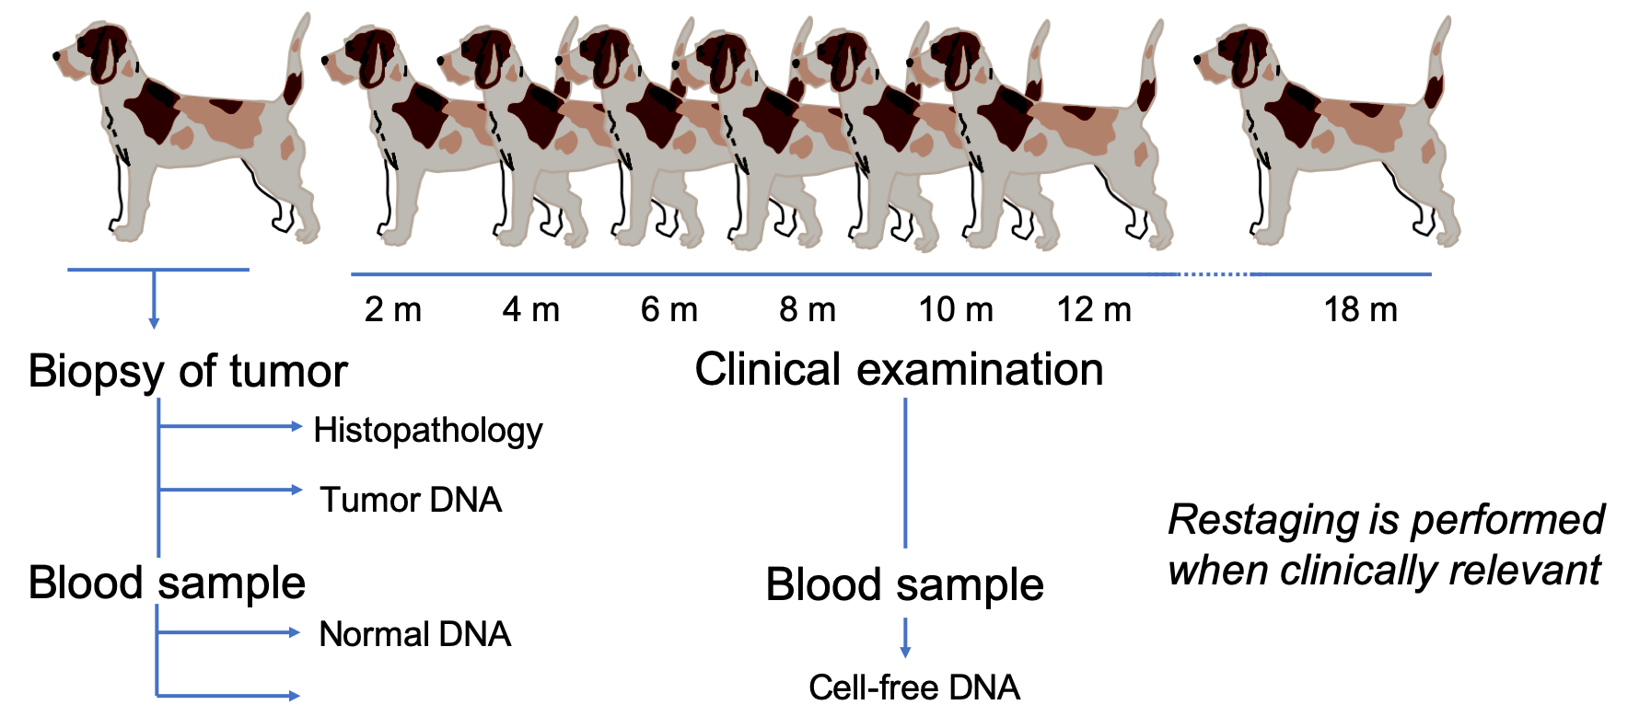
ctDNA in dogs with mammary tumors
Proof-of-concept
Is cfDNA present in dogs
Is the amount stable over time
Is ctDNA is present in these dogs?
Benign tumors
Carcinomas
Monitoring
Is ctDNA detectable before/at relapse in carcinomas?
Notes:
Right now, it’s hard to follow disease progression of cancers due to the relative low sensitivity and invasiveness of imaging modalities. We’re looking into following disease progression using liquid biopsies. The idea is to find tumor-specific mutations in the tumor and then looking for these in the liquid biopsy.
The focus is to 1) is it present 2) is it useful for tracking mammary tumor progression and tumor evolution.
Prove that ctDNA is present in dogs with aggressive mammary tumors
Follow the levels of ctDNA over time
Is ctDNA present before metastasis / regrowth is observed by conventional means?
Follow evolution of mutations over time – f.eks. For metastasis, thecells needto be able to: Go through basal membrane and invade new tissues. Tthese muttations are not necessarily present in the primary tumor.
Is the mutational pattern the same at diagnosis and at relapse?

Slide 3
Is ctDNA present in dogs with mammary carcinomas?
2 m 4 m 6 m 8 m 10 m 12 m
18 m
Biopsy of tumor
Blood sample
Clinical examination
Histopathology
Tumor DNA
Restaging is performed
when clinically relevant
Blood sample
Normal DNA
Cell-free DNA
Cell-free DNA
Notes:
Right now, it’s hard to follow disease progression of cancers due to the relative low sensitivity and invasiveness of imaging modalities. We’re looking into following disease progression using liquid biopsies. The idea is to find tumor-specific mutations in the tumor and then looking for these in the liquid biopsy.
The focus is to 1) is it present 2) is it useful for tracking mammary tumor progression and tumor evolution.
Prove that ctDNA is present in dogs with aggressive mammary tumors
Follow the levels of ctDNA over time
Is ctDNA present before metastasis / regrowth is observed by conventional means?
Follow evolution of mutations over time – f.eks. For metastasis, thecells needto be able to: Go through basal membrane and invade new tissues. Tthese muttations are not necessarily present in the primary tumor.
Is the mutational pattern the same at diagnosis and at relapse?

Slide 4
Is ctDNA present in dogs with mammary carcinomas?
2 m 4 m 6 m 8 m 10 m 12 m
18 m
Biopsy of tumor
Blood sample
Clinical examination
Histopathology
Tumor DNA
Restaging is performed
when clinically relevant
Blood sample
Normal DNA
Cell-free DNA
Cell-free DNA
Notes:
Right now, it’s hard to follow disease progression of cancers due to the relative low sensitivity and invasiveness of imaging modalities. We’re looking into following disease progression using liquid biopsies. The idea is to find tumor-specific mutations in the tumor and then looking for these in the liquid biopsy.
The focus is to 1) is it present 2) is it useful for tracking mammary tumor progression and tumor evolution.
Prove that ctDNA is present in dogs with aggressive mammary tumors
Follow the levels of ctDNA over time
Is ctDNA present before metastasis / regrowth is observed by conventional means?
Follow evolution of mutations over time – f.eks. For metastasis, thecells needto be able to: Go through basal membrane and invade new tissues. Tthese muttations are not necessarily present in the primary tumor.
Is the mutational pattern the same at diagnosis and at relapse?

Slide 5
ctDNA study - Aim
Proof-of-concept
Is cfDNA present in dogs
Is the amount stable over time
Is ctDNA is present in dogs with mammary tumors
Benign tumors
Carcinomas
Monitoring
Is ctDNA detectable before/at relapse in carcinomas
Notes:
I don’t necessarily expect the cfDNA level to be stable comparing T0 with the rest, as there’s the chance that the tumor elevate it.

